Slide 1
Deterministic QMIX - Multi-Agent Reinforcement Learning with Continuous Actions
Ipek Ilayda Onur, Tony Huang
April 26, 2023

Slide 2
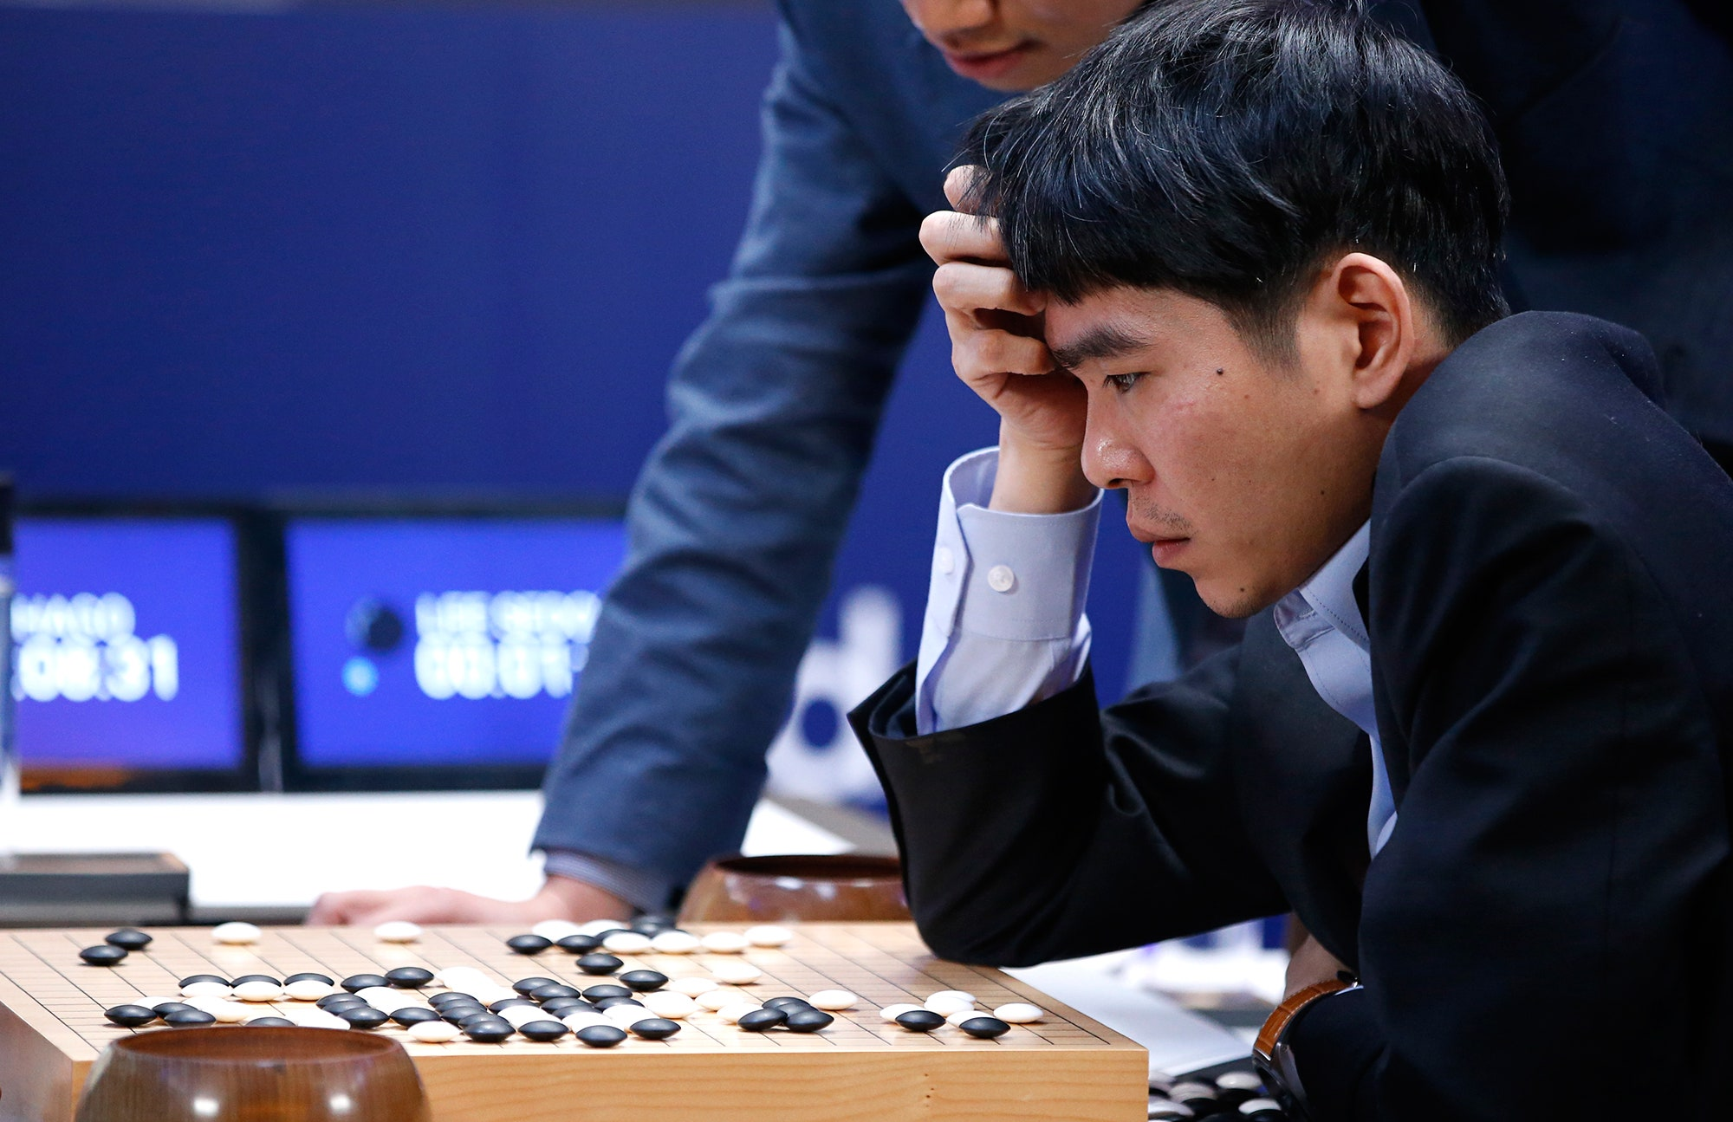
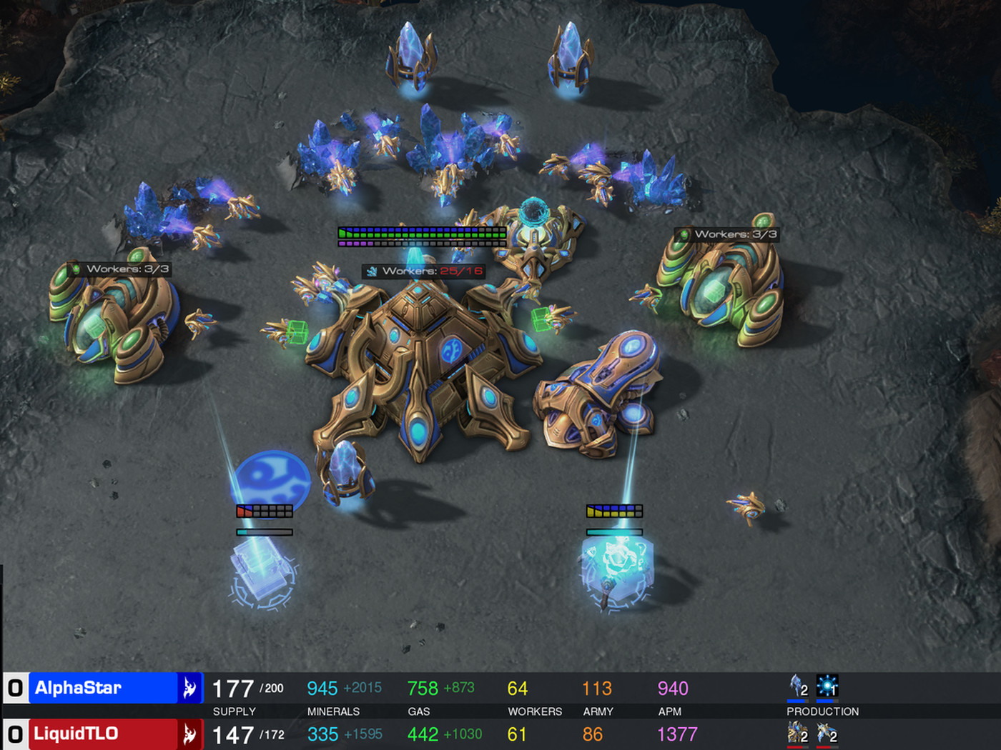
Background and Motivation for Reinforcement Learning
Reinforcement Learning (RL) is a powerful framework that trains an agent to solve complicated problems and cemented its reputation with AlphaGo’s triumph over Lee Sedol in 2016.
However, in the real and virtual world, many problem settings involve multiple players and necessitate collaboration between players.
AlphaGo vs. Lee Sedol
StarCraft II (AlphaStar)

Slide 3
Challenges in Multi-Agent Reinforcement Learning (MARL)
Credit-Assignment Problem
Non-Stationary Training
In MARL, the team of agents receives a global reward based on the agents’ joint actions.
How should we assign score to individual agent that best corresponds to the contribution of the agent’s action?
In MARL, agents are trained simultaneously and the environment changes as the agent’s policies evolve.
How should we train the agents such that they can learn to cooperatively maximize the team rewards and avoid local maxima?
Notes:
In a single-agent environment, it is easy to assign credit to the actions that led to the rewards obtained by the agent. However, in a multi-agent environment, there is a global reward and it becomes difficult to determine which actions led to the rewards obtained by an agent. This problem is further exacerbated in a partially observable environment, where agents have limited information about the state of the environment and the actions of other agents.
Non-Stationary Training refers to the challenge of dealing with the dynamic nature of the multi-agent environment. In a multi-agent environment, the actions of one agent can affect the state of the environment and the actions of other agents. This can result in a non-stationary environment where the reward function, the state transition probabilities, and the policies of the agents change over time. This makes it important to find training methods such that agents can learn to cooperatively maximize the team rewards and avoid local maximas

Slide 4
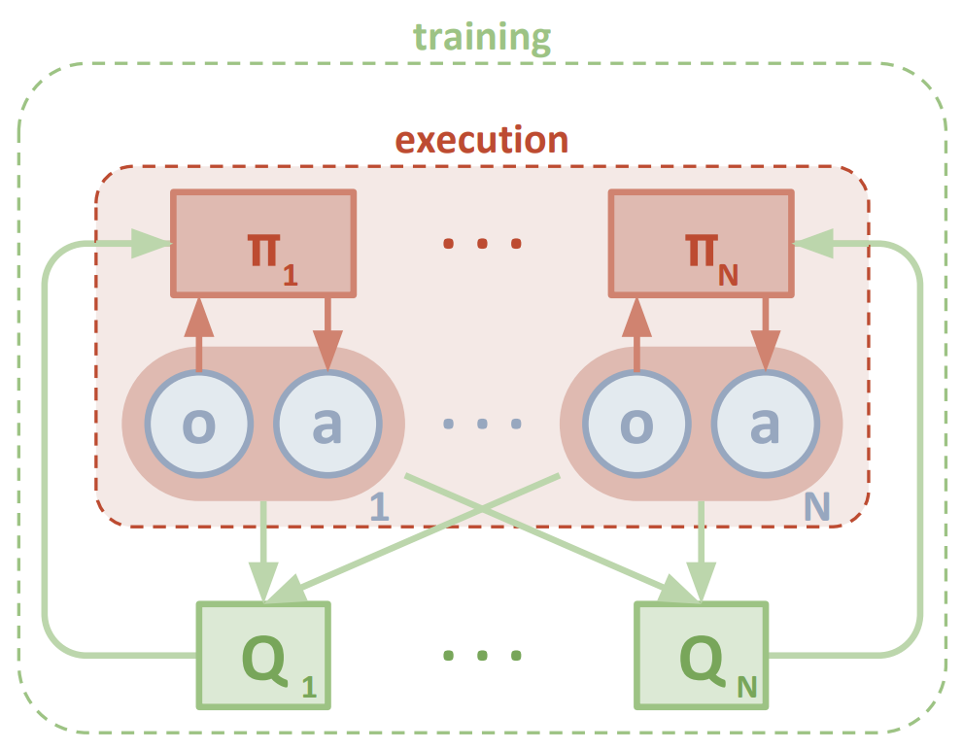
State-of-the-Art Approach in MARL: MADDPG
Multi-Agent Deep Deterministic Policy Gradient (MADDPG)
MADDPG is an extension of Deep Deterministic Policy Gradient (DDPG) actor-critic algorithm that runs on “centralized training with decentralized execution.”
In training phase, each agent’s critic receives the observations and actions from all agents as a guide for learning the optimal policy.
In execution phase, each agent uses only its own partial observation to make actions.
However, it remains unclear whether centralized critic guarantee optimal behavior between the agents?
Network Architecture of MADDPG
Notes:
Multi-Agent Deep Deterministic Policy Gradient (MADDPG) is a state-of-the-art algorithm for Multi-Agent Reinforcement Learning (MARL) developed by OpenAI. MADDPG is an extension of the Deep Deterministic Policy Gradient (DDPG) algorithm, which is a popular off-policy actor-critic algorithm for single-agent RL.
In MADDPG, each agent has its own local observation of the environment, and it learns a separate policy using its own DDPG actor-critic network. The actor network is used to output actions for the agent, while the critic network is used to estimate the state-action value function.
To enable the agents to coordinate and learn to work together, MADDPG introduces two key modifications to the standard DDPG algorithm. The first modification is the use of a centralized critic, which allows the agents to learn a joint action-value function that takes into account the actions and observations of all agents. This centralized critic is trained using a multi-agent replay buffer that stores the experiences of all agents.
The second modification is the use of a decentralized actor, which allows each agent to take actions based on its own observations and its own policy. This decentralized actor is trained using a local reward signal that is a function of the joint action of all agents.

Slide 5
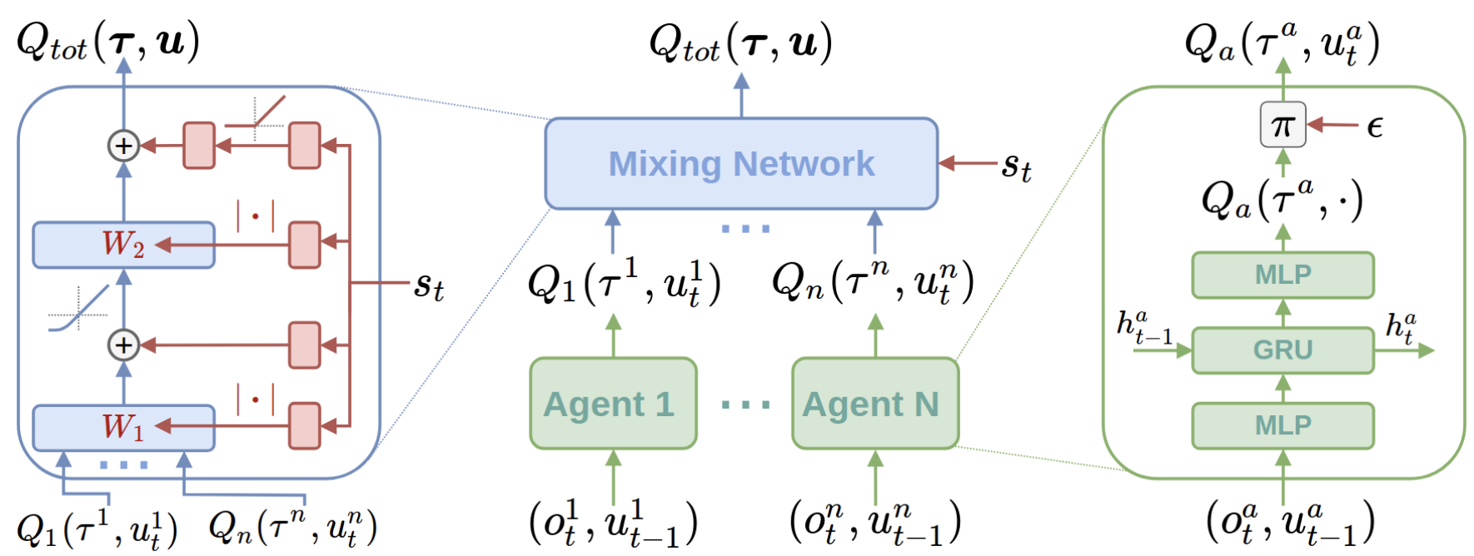
State-of-the-Art Approach in MARL: QMIX
QMIX: Monotonic Value Function Factorisation
QMIX is an extension of Q-Learning algorithm for discrete action in multi-agent setting.
QMIX enforces that the joint-action value is monotonic in the per-agent values.
It argues that the maximization of the joint action-value guarantees consistency in the agents’ policies.
Network Architecture of QMIX
Notes:
To improve optimal behavior between the agents, we introduce Qmixing to MADDPG
QMix is a state-of-the-art algorithm for multi-agent reinforcement learning (MARL) that is designed to address the challenge of learning to coordinate and cooperate in large-scale environments. QMix is an extension of the Q-learning algorithm, which is a popular model-free reinforcement learning algorithm that learns a state-action value function.
In QMix, each agent learns a separate Q-function that maps from the agent's observation and action to its expected future cumulative reward. However, unlike other MARL algorithms that use a centralized critic, QMix introduces a decentralized mixing network that combines the individual Q-values of each agent.
The mixing network is a neural network that takes as input the individual Q-values of each agent and outputs a global Q-value that takes into account the joint action of all agents. The mixing network is trained using a variant of the Q-learning algorithm that minimizes the difference between the mixed Q-value and the true Q-value.
By using a decentralized mixing network, QMix enables agents to learn to coordinate and cooperate in large-scale environments without requiring a centralized critic. This makes QMix more scalable and computationally efficient than other MARL algorithms that use a centralized critic.

Slide 6
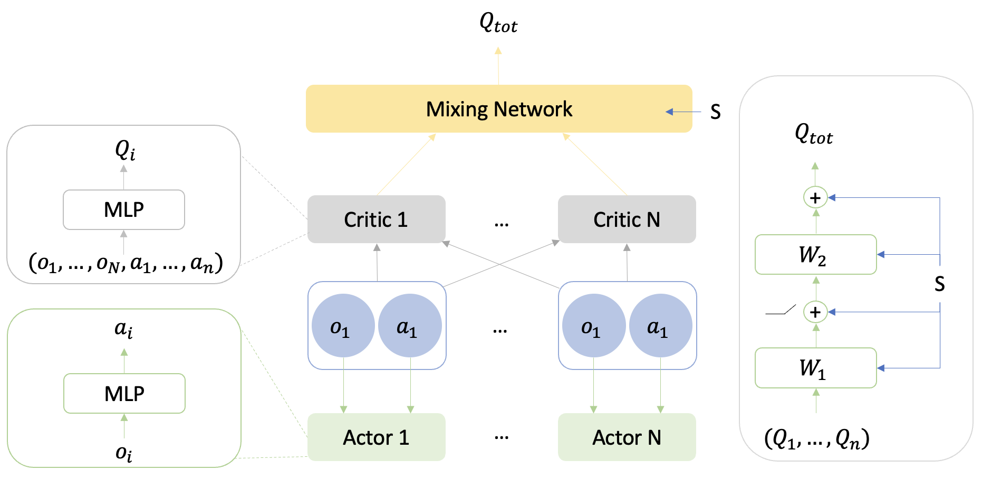
Our Proposal and Hypothesis: Deterministic QMIX
Proposal
The addition of a hypernetwork (called QMIX network) serves as a critic of the critics.
The hypernetwork receives the team’s Q values and leverages state information to output a joint Q value.
Hypothesis
The adoption of “centralized training with decentralized execution” can help overcome non-stationarity.
The non-linear (with no constraint) combination of Q values encourages cooperative behavior in the continuous action space.
Network Architecture of Deterministic QMIX
Notes:
To improve optimal behavior between the agents, we introduce Qmixing to MADDPG
QMix is a state-of-the-art algorithm for multi-agent reinforcement learning (MARL) that is designed to address the challenge of learning to coordinate and cooperate in large-scale environments. QMix is an extension of the Q-learning algorithm, which is a popular model-free reinforcement learning algorithm that learns a state-action value function.
In QMix, each agent learns a separate Q-function that maps from the agent's observation and action to its expected future cumulative reward. However, unlike other MARL algorithms that use a centralized critic, QMix introduces a decentralized mixing network that combines the individual Q-values of each agent.
The mixing network is a neural network that takes as input the individual Q-values of each agent and outputs a global Q-value that takes into account the joint action of all agents. The mixing network is trained using a variant of the Q-learning algorithm that minimizes the difference between the mixed Q-value and the true Q-value.
By using a decentralized mixing network, QMix enables agents to learn to coordinate and cooperate in large-scale environments without requiring a centralized critic. This makes QMix more scalable and computationally efficient than other MARL algorithms that use a centralized critic.

Slide 7
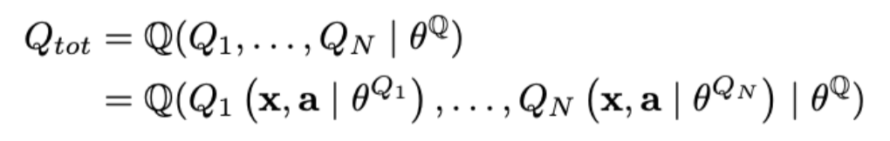
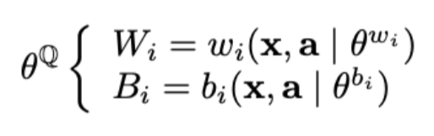
Our Proposal and Hypothesis: Deterministic QMIX
1
Joint-Value
1
The mixing network inputs individual critic value and outputs joint value.
2
2
State Information
The weights and biases of the network incorporates global state information.
Network Architecture of Deterministic QMIX

Slide 8
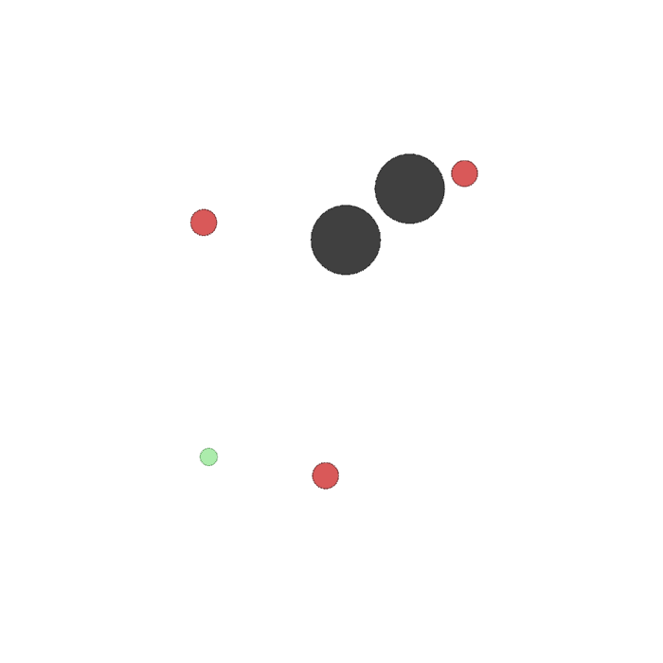
Experiment Setting: Multi Particle Environment (MPE)
Environment
Algorithm performance should be evaluated in environment that requires collaboration between agents.
MPE is a set of collaborative 2D games, and we will specifically focus on the predator-prey (or hide-and-seek) game.
Setting
Black circles represent environment obstacles.
Red circles are adversarial agents, who receive a positive reward for hitting the good agent.
Green circles are good agents, who move faster and receive a negative reward for being hit by adversaries.
Predator-prey scenario

Slide 9
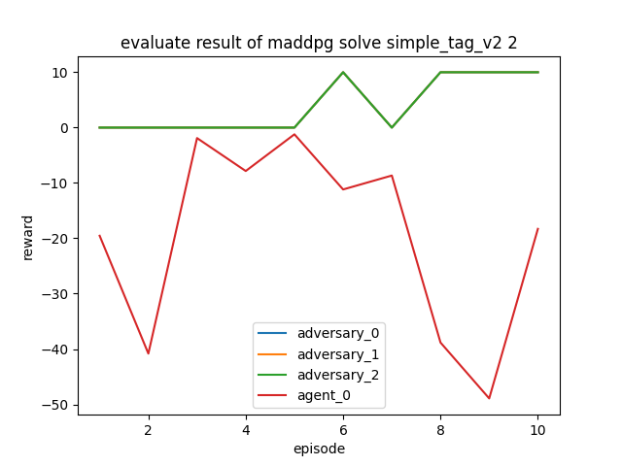
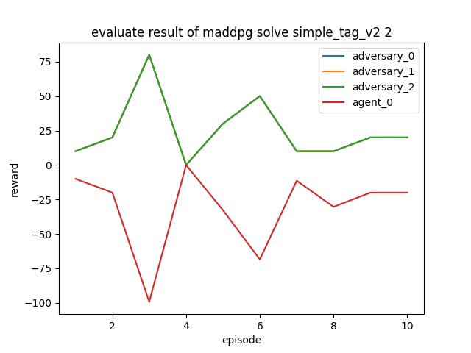
Experiment Results and Algorithm Comparison
We train the agents for 30,000 episodes (20 steps / episode) and evaluate the performance for 10 episodes.
MADDPG: the agent obtains the minimum rewards of -50, while the adversary achieves maximum rewards of 10.
QMIX: the agent obtains the minimum rewards of -100, while the adversary achieves maximum rewards of 75.
MADDPG Evaluation Performance
QMIX Evaluation Performance

Slide 10
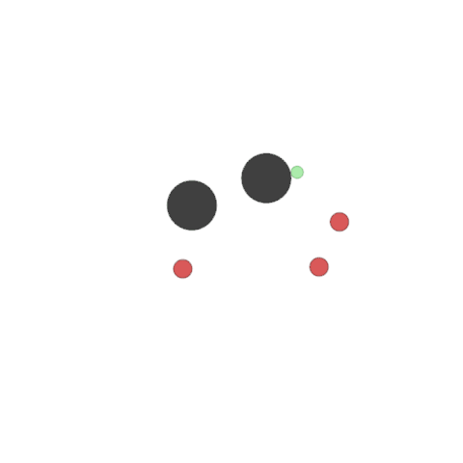
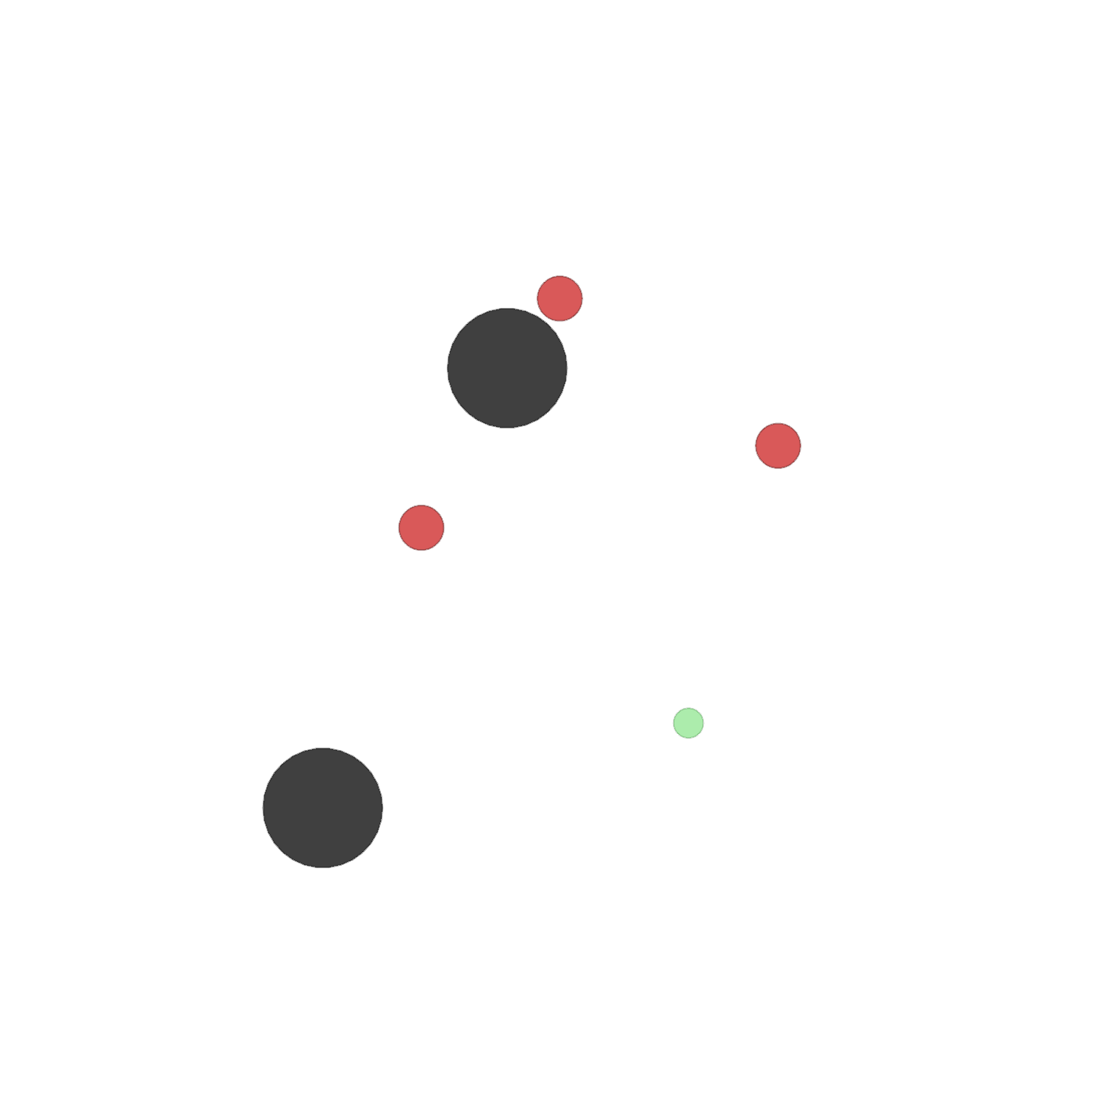
Visualization of Agents’ Collaborative Behavior
MADDPG Performance
QMIX Performance
Notes:
As we know, networks play an important role in our daily life and robustness is a critical feature of the network. Whenever nature seeks robustness, it resorts to networks Therefore, in this project, we are interested in studying how one can best attack and defend a network and evaluate its robustness.

Slide 11
Summary of the Project’s Main Contributions
We introduce a new network architecture for multi-agent actor-critics that can generate a joint-value based on the per-agent value, without imposing any assumed constraints.
We incorporate centralized training with decentralized execution in the training scheme, whereby the agents learn continuous actions and maximize the joint-value.
Notes:
As we know, networks play an important role in our daily life and robustness is a critical feature of the network. Whenever nature seeks robustness, it resorts to networks Therefore, in this project, we are interested in studying how one can best attack and defend a network and evaluate its robustness.

Slide 12
Contribution
Both members contribute equally to the literature review, experiment (experimentation and validation), and report/presentation writing.
Notes:
As we know, networks play an important role in our daily life and robustness is a critical feature of the network. Whenever nature seeks robustness, it resorts to networks Therefore, in this project, we are interested in studying how one can best attack and defend a network and evaluate its robustness.

Slide 13
Selected References
Sutton et al. Reinforcement learning: An introduction, volume 1.
Silver et al. Human-level control through deep reinforcement learning.
Silver et al. Mastering the game of go with deep neural networks and tree search.
Silver et al. Deterministic Policy Gradient Algorithms.
Silver. UCL Course on RL.
Lowe et al. Multi-Agent Actor-Critic for Mixed Cooperative-Competitive Environments.
Rashid et al. Monotonic Value Function Factorisation for Deep Multi-Agent Reinforcement Learning.
Notes:
As we know, networks play an important role in our daily life and robustness is a critical feature of the network. Whenever nature seeks robustness, it resorts to networks Therefore, in this project, we are interested in studying how one can best attack and defend a network and evaluate its robustness.

Slide 14
Questions?
Notes:
As we know, networks play an important role in our daily life and robustness is a critical feature of the network. Whenever nature seeks robustness, it resorts to networks Therefore, in this project, we are interested in studying how one can best attack and defend a network and evaluate its robustness.

